Slide 1

Project Title -Seasonal Agriculture Performance Analysis
Student Name - Uttam Das
College Name: Academy of Business Administration
AICTE STU ID : STU6a6636cfe97b11785083599

Slide 2

PROBLEM STATEMENT
Agricultural activities are influenced by seasonal variations in environmental conditions, farming practices, resource availability, and market conditions. As a result, agricultural performance may differ from one season to another.
However, raw agricultural data does not clearly explain how agricultural performance changes across seasons or what patterns can be observed in different seasonal conditions.
The problem is to analyze the given agricultural dataset and investigate seasonal differences in agricultural performance by identifying meaningful patterns, trends, relationships, and variations within the available data.

Slide 3
Project Description
This project performs an Exploratory Data Analysis (EDA) and quantitative assessment on agricultural performance data across different cropping seasons (Kharif, Rabi, and Zaid).
Key Highlights:
Analyzes climatic parameters such as average temperature, rainfall, humidity, and sunlight hours alongside agricultural metrics like farm yield, total production, revenue, costs, and profit margin.
Evaluates crop distribution across major crops including Rice, Wheat, Maize, Cotton, Pulses, Groundnut, Chilli, and Sugarcane.
Uses statistical techniques, pair plots, and correlation heatmaps to reveal non-linear dependencies, financial viability, water usage efficiency, and disease/pest risk across seasonal cycles.
Translates raw multi-variable farm records into actionable insights for optimized resource allocation and seasonal risk mitigation.

Slide 4

WHO ARE THE END USERS?
Farmers & Agricultural Producers: Helps optimize seasonal crop selection, manage input costs, and improve profit margins based on historical climate data.
Agricultural Policy Makers & Government Bodies: Assists in designing seasonal subsidy schemes, irrigation planning, and crop insurance policies.
Agri-Tech Companies & Advisors: Provides data-driven insights to build predictive advisory tools for precision farming and pest control.
Supply Chain & Market Analysts: Facilitates demand-supply forecasting and market price trend analysis across different harvesting seasons.

Slide 5

Technology Used
Programming Language: Python
Data Manipulation & Analysis: Pandas, NumPy
Data Visualization: Matplotlib, Seaborn
Development Environment: Jupyter Notebook / Google Colab / VS Code
Version Control & Repository: GitHub

Slide 6
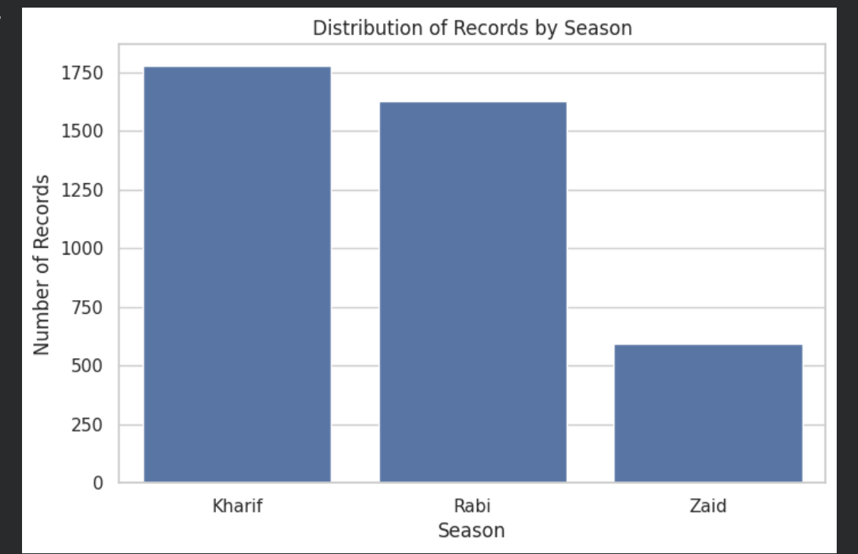
RESULTS

Slide 7
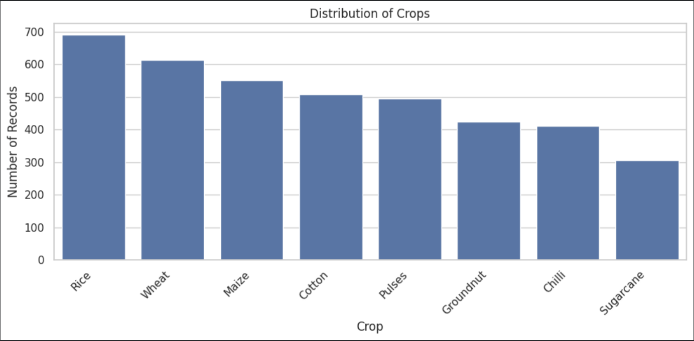
RESULTS

Slide 8
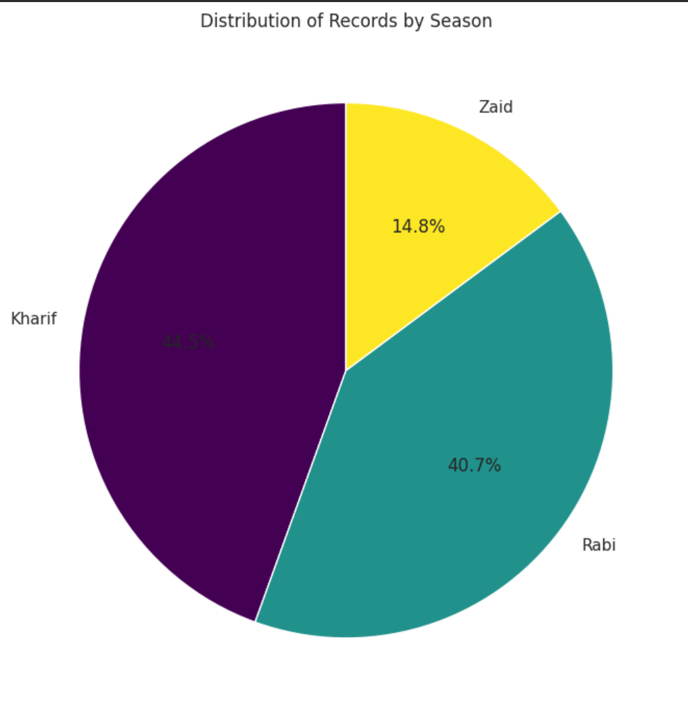
RESULTS
[Add screen shots of your code ]

Slide 9
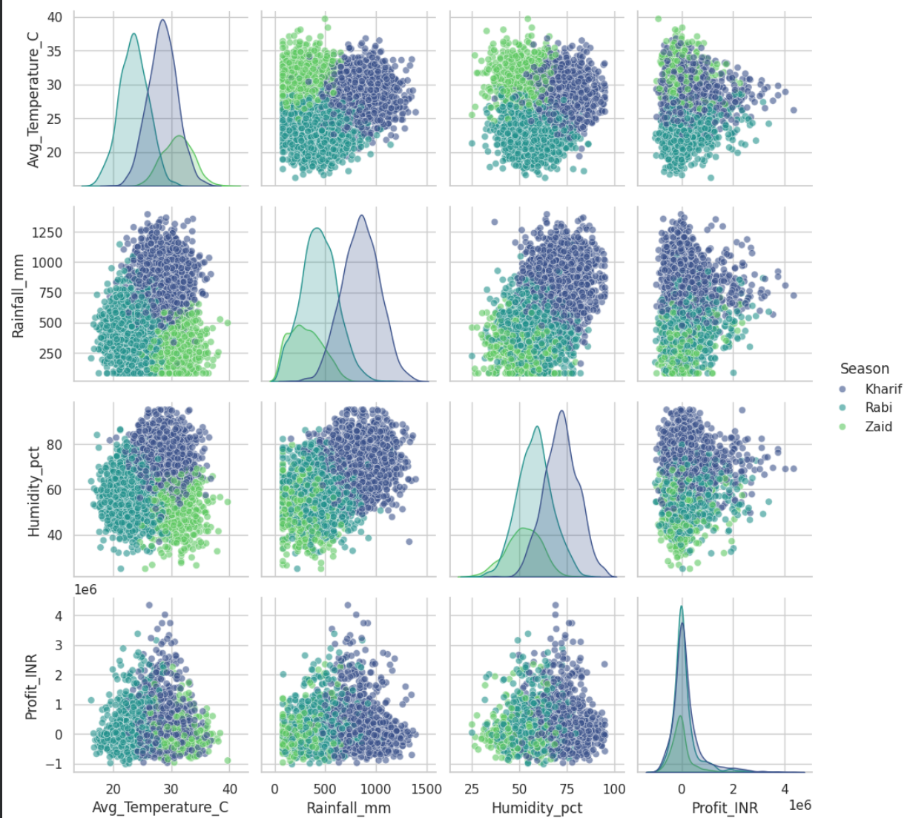
RESULTS
[Add screen shots of your code ]

Slide 10
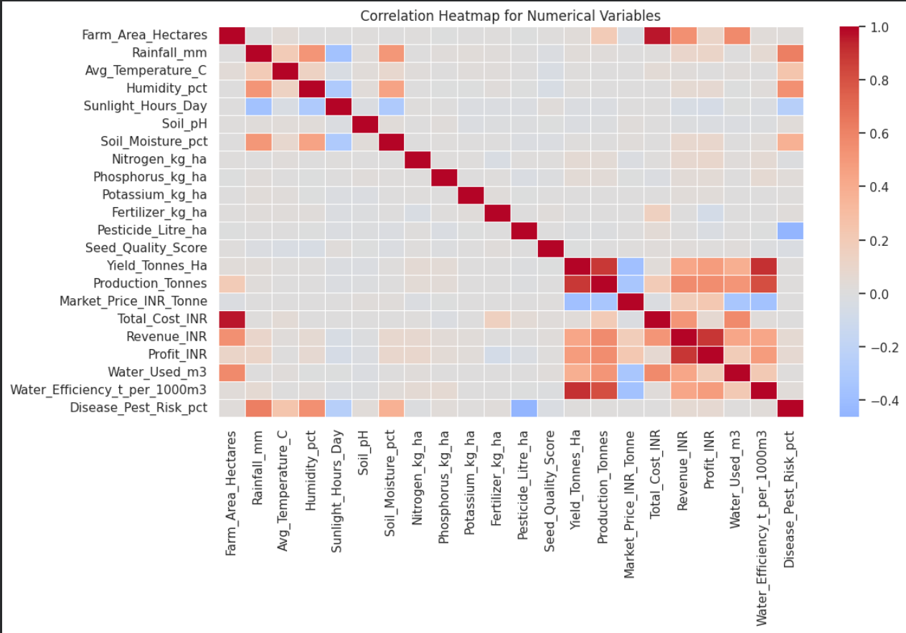
RESULTS
[Add screen shots of your code ]

Slide 11
Future scope
Machine Learning Predictive Modeling: Implement regression and classification algorithms (e.g., Random Forest, XGBoost) to forecast yield and profit potential based on real-time weather forecasts.
Interactive Web Dashboard: Develop an interactive Streamlit or Dash web interface allowing farmers and agronomists to filter data dynamically by region, crop type, and season.
Integration with Real-Time IoT & Satellite Data: Incorporate real-time soil moisture sensors, weather API integration, and remote sensing/satellite imagery for live field monitoring.
Optimization Engine: Build an automated recommendation system to suggest optimal fertilizer dosage, irrigation scheduling, and pest control measures tailored to seasonal climate shifts.

Slide 12
GitHub Link
https://github.com/UttamDas6/Seasonal-Agriculture-Performance-Analysis.git

Slide 13
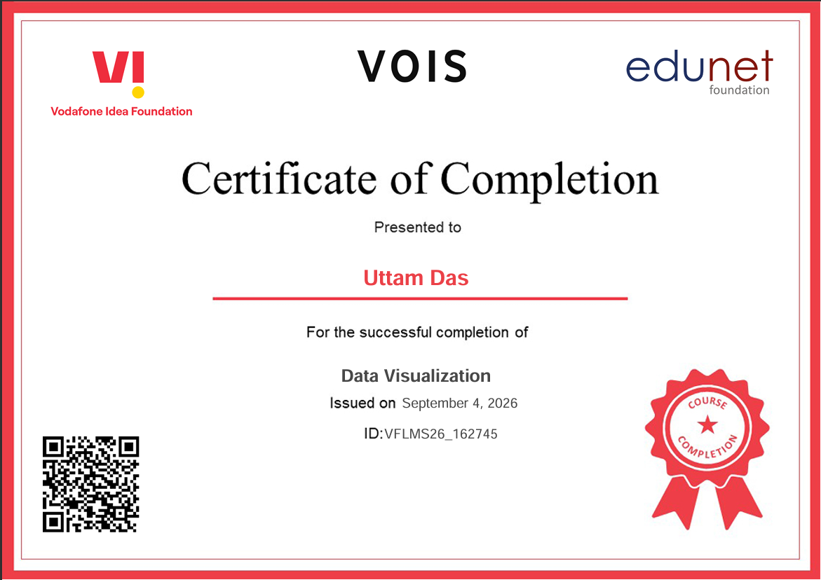
VOIS Course completion certificate - Course name- Data Visualization

Slide 14
Thank you
.
.

